Slide 1
HINDHI WORDS
Presented BY
Sushil Varma

Slide 2


Slide 3
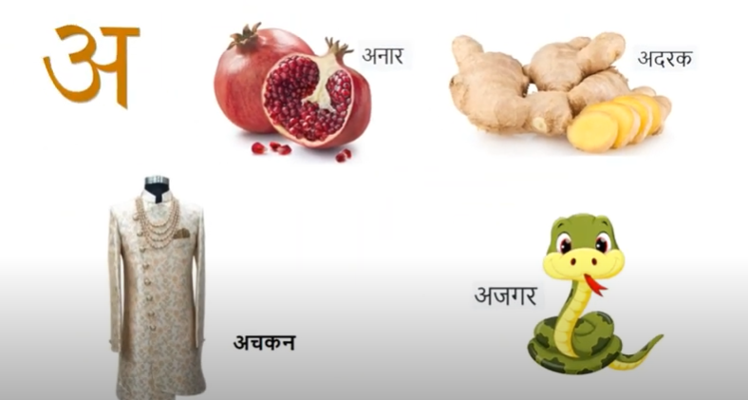

Slide 4


Slide 5
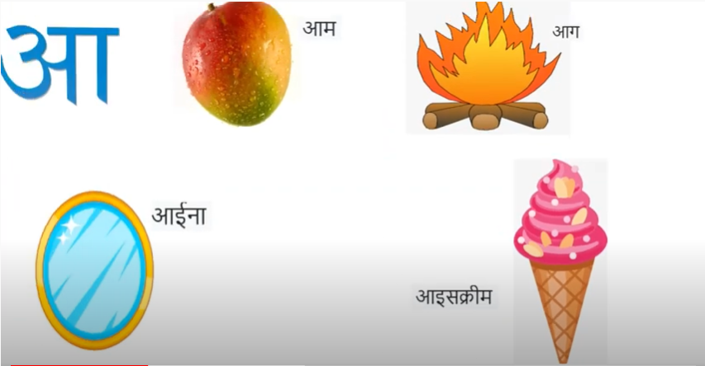

Slide 6


Slide 7
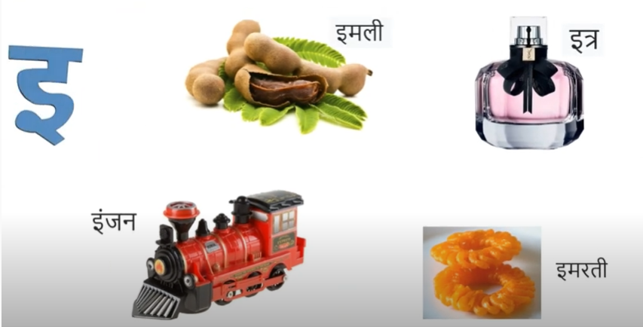

Slide 9
THANK YOU

